Slide 1
Formatting LWA data for SSINS
Jon Julius

Slide 2
Summary
Introduction and Familiarization
Getting PYUVData to read data
Investigating the Data
Results for Now
Future Work

Slide 3
Introduction
SSINS used to remove RFI from data
LWA is an observatory down in New Mexico

Slide 4
Familiarization
Ran MWA through SSINS
Used dictionary of already known RFIs
Worked out how key components were calculated and used

Slide 5
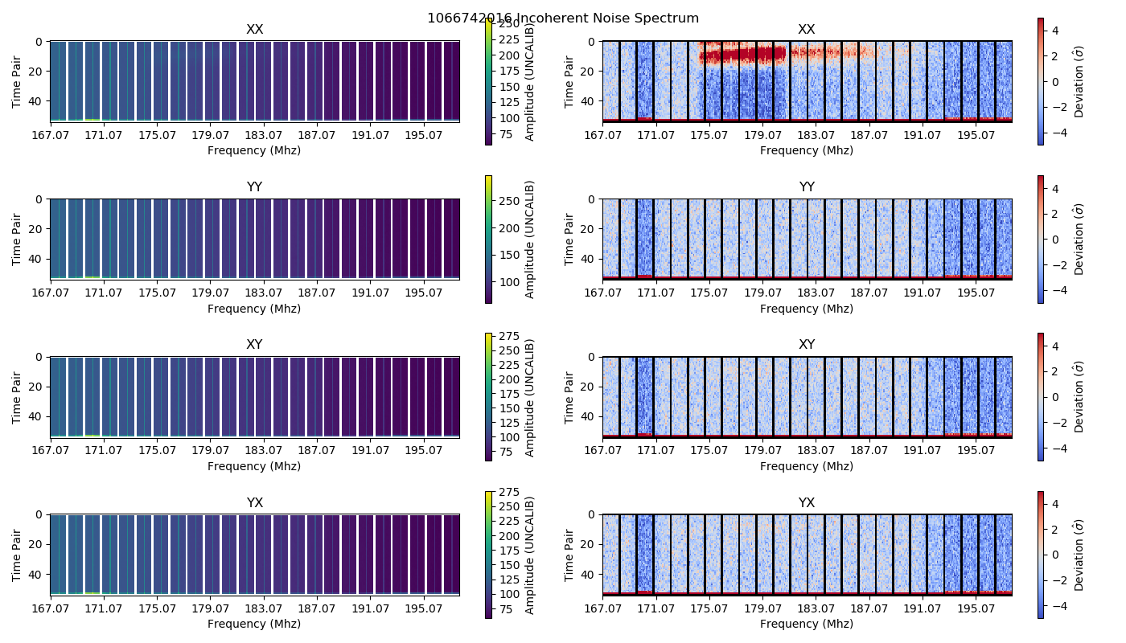
MWA Data

Slide 6
Data Wouldn’t Read
Mike investigated the error
PYUVData made assumptions about the organization of data
An Empty History table produced an Error
A “weights spectrum” column was expected in the Set
No needed if “Weights” is filled out
Mike Created a branch on the pyuvdata repo
Bryna tested the code and merged it into the master

Slide 7
File Organizational Chaos
Information in the file names
test_adp1_0_00300674099096000000_58342_05_39_56.ms
test_adp1_0_00300674099096000000_58342_05_40_06.ms
test_adp2_0_00300674099096000000_58342_05_39_24.ms

Slide 8
Checking Our Hypothesis
ADP were frequencies
Range from 34.6 MHz – 45.4 MHz
Each ADP had a range of 1.75 MHz
Adjacent files were 10 seconds apart
Only a single integration time per file

Slide 9
Combination Woes
Parameter Incompatibilities
Data was phased different
Odd issue combining different frequency arrays

Slide 10
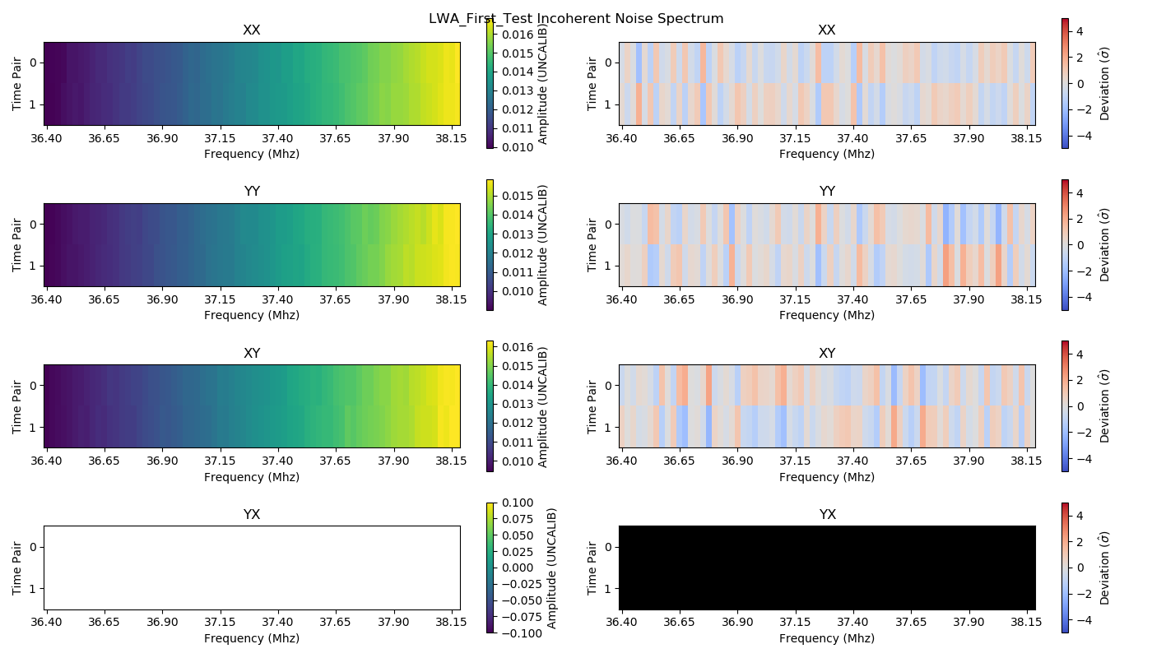
The Issue with YX

Slide 11
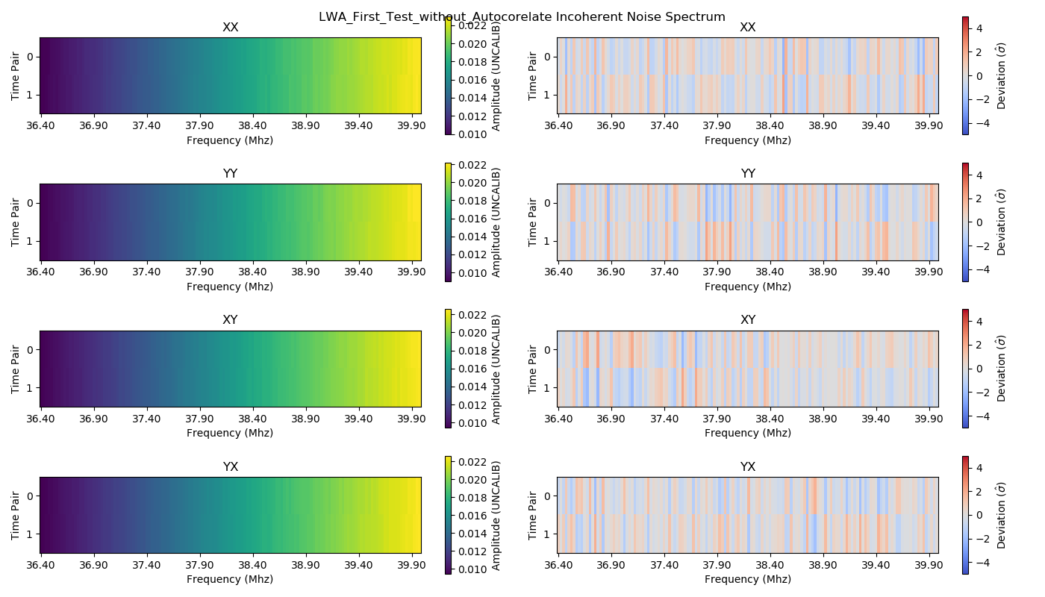
The Solution with YX

Slide 12
Where I Am Now
Going to run 6, ten minute chunks for a full read of data
Find RFI shapes
Run data through Match_Filter
Who knows what fun errors awaits there!

Slide 13
Special Thanks
Mike Wilensky
Bryna Hazelton

